Slide 1
Design Review
Hunter, Frankie and Kiley

Slide 2
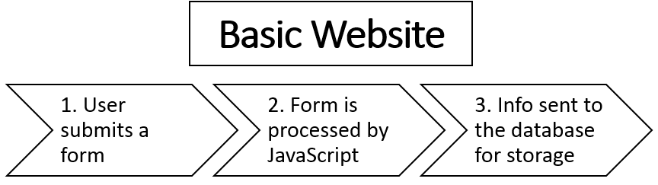
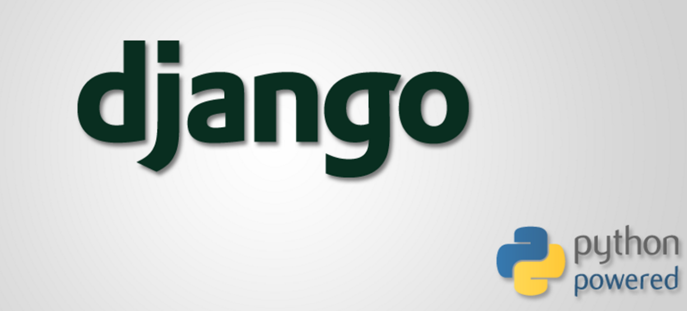
Our Project
Using Django: Python’s web development package
-Django’s Goal: ease the creation of complex, database-driven websites
-Currently reading the django book and experimenting

Slide 3
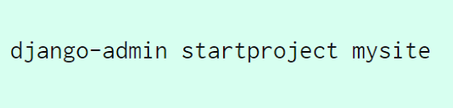
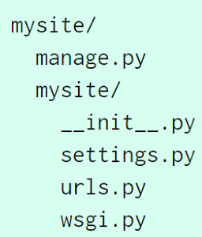
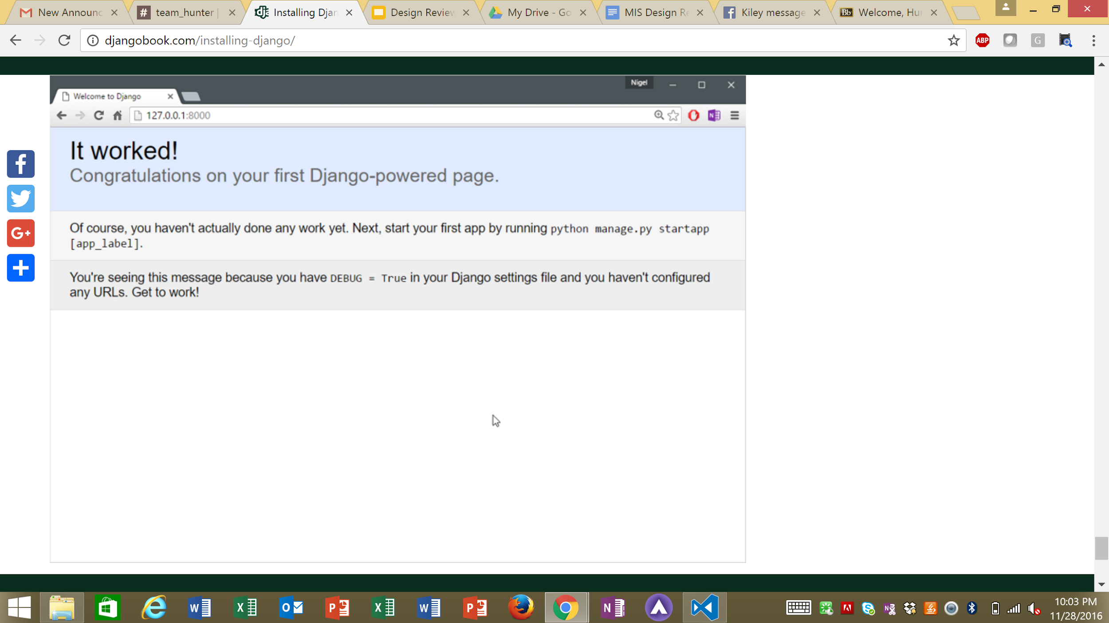
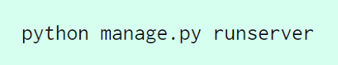
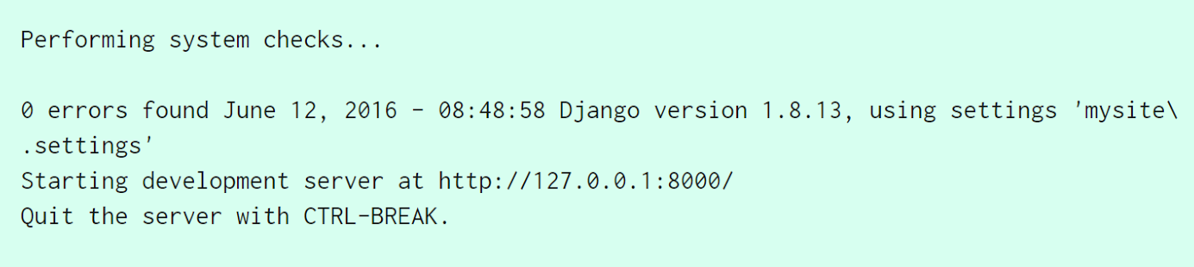
Software Architecture
Python serves as a powerful shell for a system
New Project Contains:
A SQL-lite database
URLconf
Views
(To the right) Example of a Django Project
Goal:
Have django render our website template
Link backend database to store the information
** Similar to the project we did for flask

Slide 4
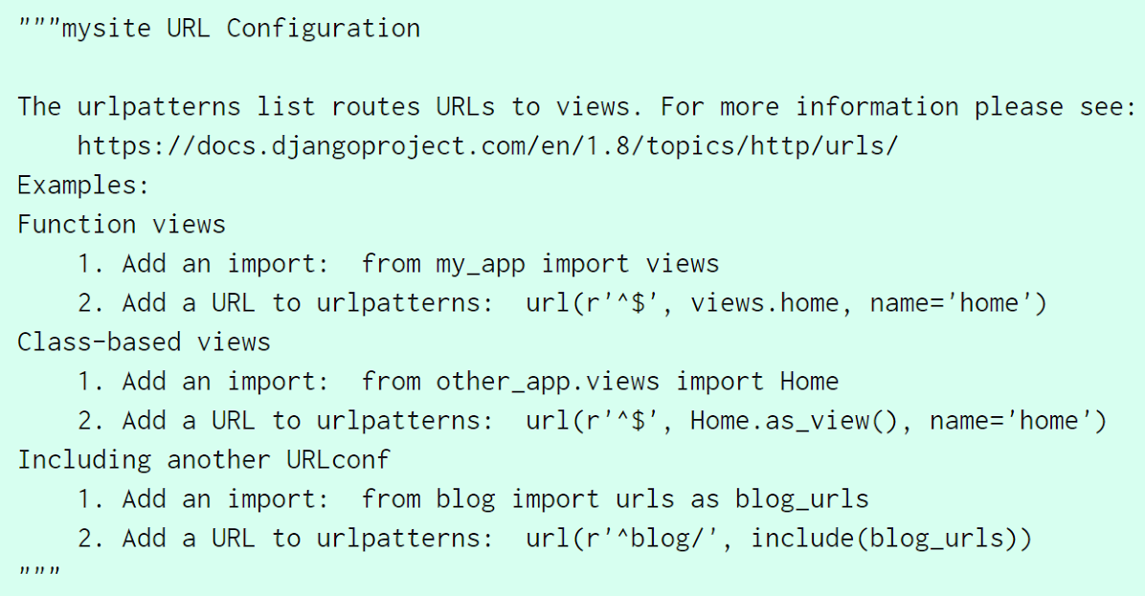
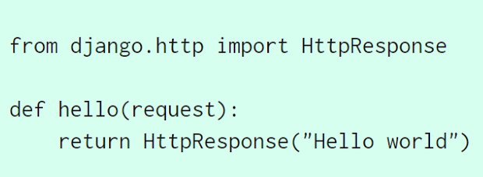
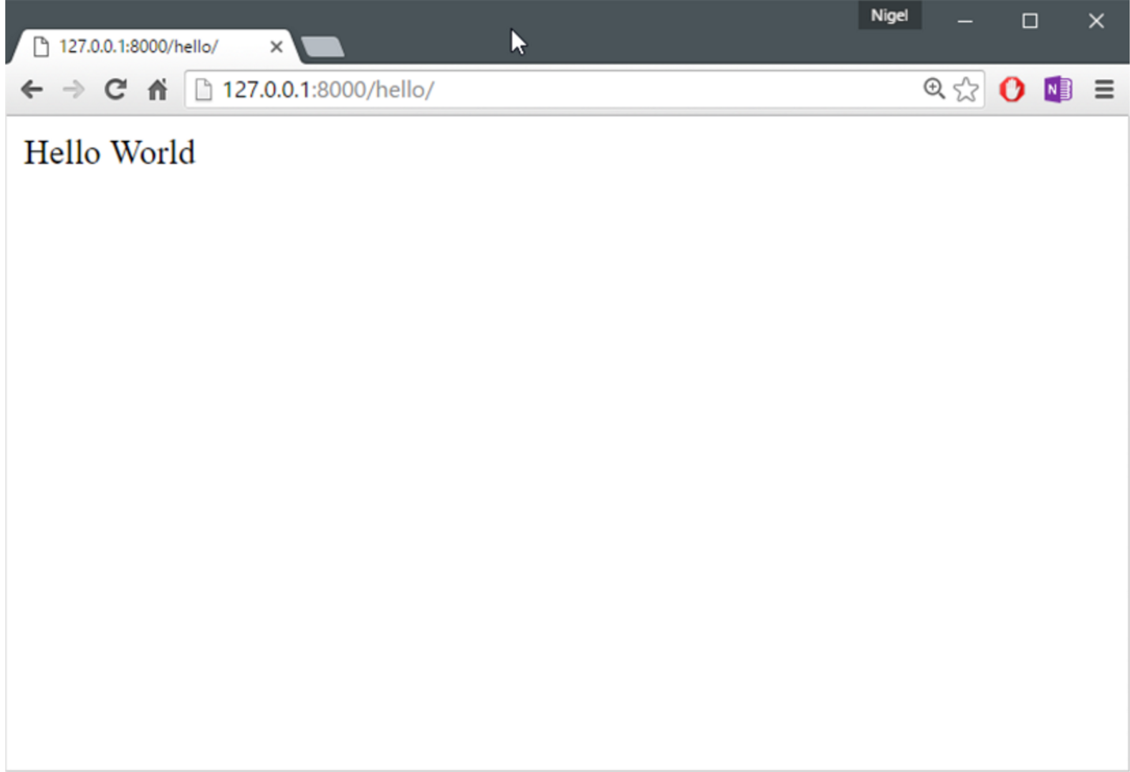
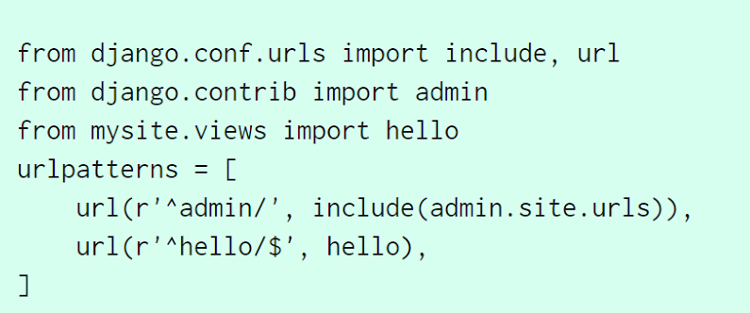
Basic Demonstration
URLconf
Views
Result

Slide 5
Help Moving Forward
Next Steps:
How to build the database
Having django render our template
Outside Perspective On:
Development process - do people have similar projects or experience with django?
Should we switch to flask?

